Slide 1



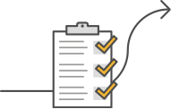
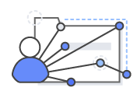




Database Migration Customer Journey
ASSESSMENT
READINESS & PLANNING
DATABASE MIGRATIONS
Assess Databases
Establish Governance & Program Management
Migrate Databases At-Scale
Proserve / GCC
Rapid
Discovery
Define
Governance
Build Core
DB Team
Education &
Training
Building a
DB Pipeline
Estimate Effort
(DBAF)
DMA Factory
Directional
Business Case
Engaging Migration
Teams (DMA,
Partners, GCC)
Building
Migration
Dashboards
Define Migration Metrics
Pilot
Migrations
Partner Teams
Customer Teams

